Slide 1

E-Business and E-Commerce

Slide 2
Definition: Electronic Business (U.S. Census Bureau)
An process that an organization conducts over a computer-mediated network
Production – procurement, ordering, stock replenishment, payment processing, production control, etc.
Customer-focused – marketing, selling, customer order processing, etc.
Internal or management-focused – employee service, training, recruiting, information sharing, etc.

Slide 3
Definition: Electronic Commerce
Any transaction completed over a computer-mediated network that involves the transfer of ownership or rights to use goods or services.
Completed transactions may have a zero price.

Slide 4
Definition: Electronic-Business Infrastructure
The share of total economic infrastructure used to support e-business processes and conduct e-commerce transactions.
Hardware
Software
Telecommunication networks
Support services
Human resources

Slide 5
Definition: Computer-Mediated Networks
Electronically-linked devices that communicate interactively over network channels.
Computers, personal digital assistants, web TV
Internet-enabled cellular phones, interactive telephone systems
Internet, intranets, extranets, telecommunication networks, EDI

Slide 6
New Business Rules from E-Business
Customers determine everything.
Knowledge and information become more valuable than physical assets.
People want more choices of products and services.
Time is present time, distance is zero.
Technology and network determine how the business is conducted.

Slide 7
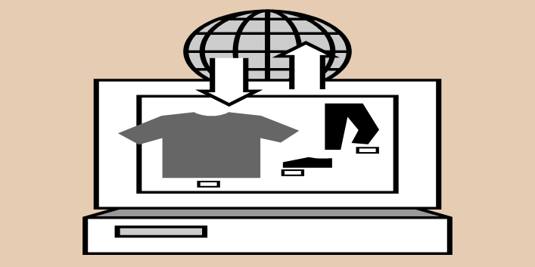
What Are the Potential Benefits of E-Business?

Slide 8
Potential Benefits of E-Business
More product/service selections
Higher Productivity
Improved accessibility and convenience
Better availability of information
Shorter lead time
Improved communication
Stronger competitive position

Slide 9

Examples of E-Business Applications?

Slide 10
Categories of E- Business Applications (BW, Nov. 24, 2003)
Collaboration
Customer Service
Customization
Streamlining
Management
Cutting Edge

Slide 11
Examples of E-Business Applications
Cisco (financial management)
Nike (product design)
Jet Blue Airlines (customer service & ticketing)
Dell Computer (customer ordering & service)
Boeing (flight manuals, maintenance documents, spare parts to order)
Garden.com (drop ship)
AlliedSignal (operations scheduling & supply chain)
Starbucks (smart cards & web access)

Slide 12

How Can An Automobile Manufacturer Apply E-Business?

Slide 13
How Can An Automobile Manufacturer Apply E-Business?
Sales
Customer Service
Supplier management
Marketing
Product Design
Financing
Employees Training

Slide 14
The Internet’s Influence on Industry Structure – Michael Porter
Bargaining power of supplier
Bargaining power of buyers
Rivalry among existing competitors
Barriers to entry
Threat of substitute products or services

Slide 15
Launching E-Business Initiatives
Define what an e-business initiative means for the organization.
Ask key questions to develop a strategy.
Communicate the plan to executives and employees extensively.
Prepare for mistakes and develop effective recovery systems.

Slide 16
Types of E-Commerce
Customer-to-Customer (C2C)
Business-to-Customer (B2C)
Business-to-Business (C2C
Government-to-Business (G2B)
Government-to-Citizens (G2C)

Slide 17
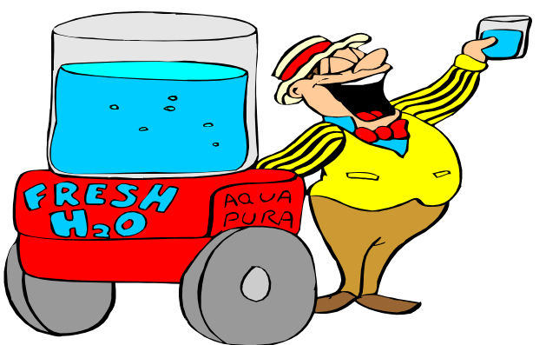
Examples of E-Commerce?

Slide 18
Examples of E-Commerce
Retailing and Marketing
Entertainment and Travel
Education and Learning
Banking and Investment
Health-Care
Auction
Personal and Business Service

Slide 19

Who Are Potential E-Commerce Supply Chain Members?

Slide 20
Potential Supply Chain Members of E-Commerce
End users
E-store
payment processor
Distributors’/Producers’ supply chain
Transportation/logistics providers
Customer service providers

Slide 21
Application of the Internet in Value Chain (Michael Porter)
Improving operational effectiveness versus improving strategic positioning
Effects on stages in the value chain
Inbound Logistics
Operations
Outbound Logistics
Marketing and Sales
After-Sales Service

Slide 22
Basic E-Commerce Strategies (P. Evans & T. Wurster, HBR, 1999)
Reach (access and connection with customers)
Richness (depth and detail of information to/from customers)
Affiliation (advancing customers’ interests)

Slide 23
Key Business Drivers of E-Commerce
Internet
Information
Collaboration
Agility
Speed
Service

Slide 24
Competitive Advantages of E-Commerce
Offers personalized products/services
Enables customer self-service
Reduces lead time
Reduces overall cost for seller and customers
Improves utilization of resources throughout the supply chain
Increases customer satisfaction and loyalty
Expands to global marketplace

Slide 25

What Could Be the Tasks Performed by Customers?

Slide 26
Tasks Performed by Customers
Browse catalogs
Conduct research on products/services
Configure and place orders
Look up pricing
Look up lead time and order status
Access invoicing information
Access customer service information

Slide 27
B2C E-commerce Implementation Strategies
Educate the customer
Make the shopping fun
Serve customers well
Personalize the sales pitch
Cross sell and up sell
Low price
Painless returns

Slide 28
Ways to Improve E-Commerce Operations
Technology (hardware and software)
Business Process Reengineering
Agile production (mass customization)
Just-in-time system
Supply chain management
Business intelligence
Customer relationship management

